Slide 1

Wine Quality
Analysis
BIT 5534 Project Report (Group #4)
Reinee Erickson
Jon Stonebraker
Ishwarya Vasan
Notes:
Isa: Hi This is Group 4, Reinee, Jon and Ishwarya presenting our analysis on wine quality.

Slide 2
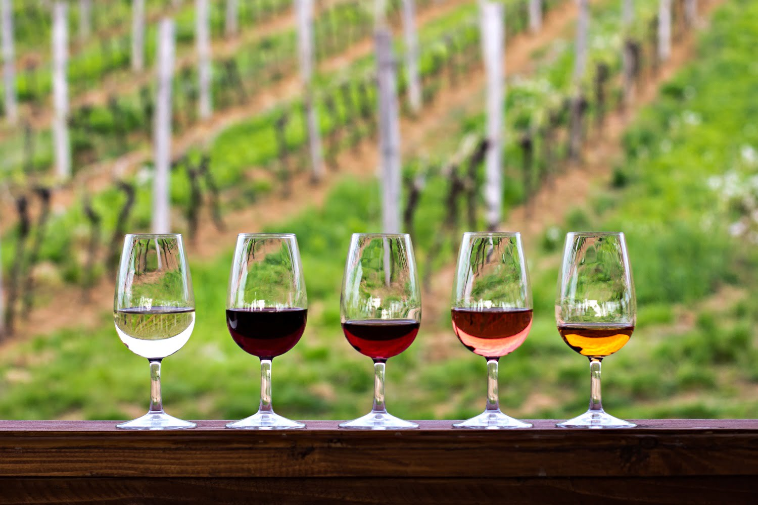
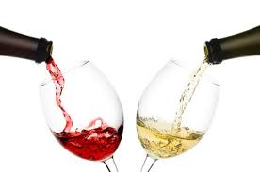
Business Problem and Questions
Wine quality testing can be a complex task for a laboratory with numerous analysis and factors to monitor
Measuring how customers rate (on a scale of 0-10) any given bottle of wine using common factors will help wine distributors produce better quality wines and improve their sales revenue
Our predictive algorithms make this analysis of wine easier and more efficient
The algorithm includes multiple factors of wine like fixed acidity, volatile acidity, citric acid, chlorides, density, pH, etc., and analyze their impact of quality of the wine
a. Which variables affect the quality of red wine?
b. Which variable affects the quality of white wine?
c. How does alcohol levels affect the quality of wine?
d. Does fixed acidity improve the quality of wine?
Notes:
Model analysis is wide-spread and has many applications in various fields. The intention of this analysis on red and white wine is to predict the quality of the wine based on the predictors. The analysis is done through comparing several models, including Logistic Regression, Decision Tree and Stepwise Regression models. Model performance will be compared through a training/test set split while considering various factors of wine like • fixed acidity, volatile acidity, citric acid, chlorides, density, pH
Reinee:
The primary research objective was to identify the variables that determine the quality of wine. We will analyze the data to answer the questions shown on the slide: Which variables affect the quality of red wine? Which variable affects the quality of white wine? How does alcohol levels affect the quality of wine? Does fixed acidity improve the quality of wine? The information gathered from answering these research questions will allow our team to make recommendations to wine makers as to which variables have the greatest impact on the quality of the wine that they produce.

Slide 3
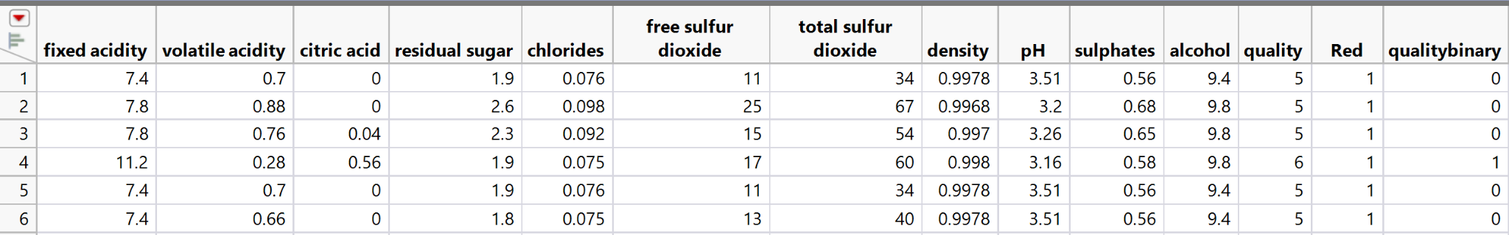
Data Description
Datasets consist of red and white wine variants of Portuguese ‘Vinho Verde’ wine
Dataset sourced from the University of California Irvine (UCI) Center for Machine Learning and Intelligent Systems
Contains a total of 6,497 records and thirteen variables
A dummy variable added to differentiate red and white wine for comparison
Binary variable added to denote a wine with a quality score from 0-5 (0) and 6-10 (1)
Notes:
The dataset used for this analysis consisted of red and white wine variants for Portuguese “Vinho Verde” wine. The data was sourced from the University of California Irvine (UCI) Center for Machine Learning and Intelligent Systems. The complete data set contains 6,497 records with thirteen provided variables. In order to distinguish red from white a dummy variable was added by the team denoting red wine records with a 1 and white wine records with a 0. The team also created a binary variable data based on the quality score given to the wine during custom evaluation. Wines receiving a quality score from 0 to 5 were given a 0 and wines receiving a quality score from 6 to 10 were given a 1. The quality variable was used as the dependent target variable for all models.

Slide 4
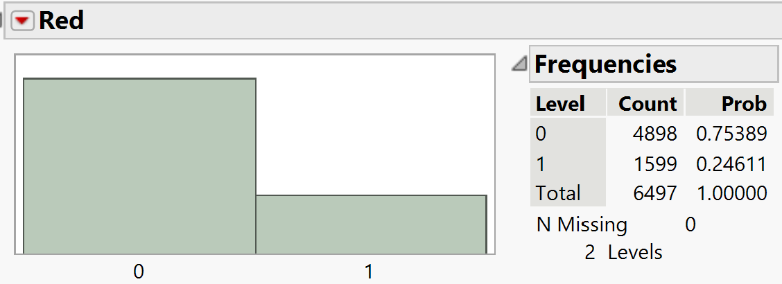
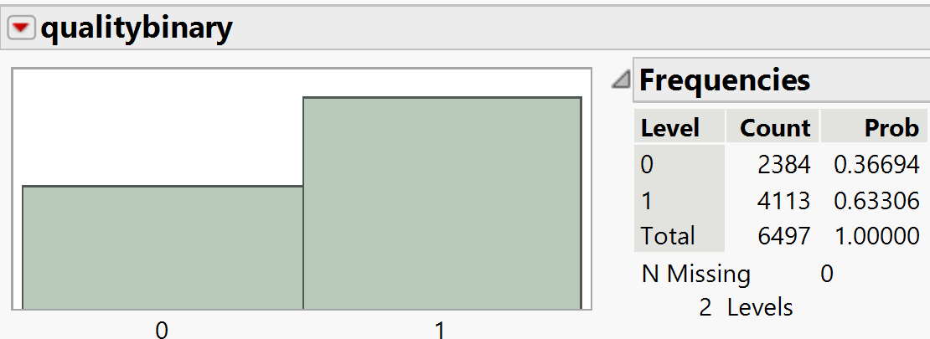
Data Distribution
Wine Distribution
All 6,497 records had a wine designation
4898 or 75.3% of the records are classified as white wine
1599 or 24.7% of the records are classified as red wine
Quality Distribution
All 6,497 records have a quality score
Records were assigned a binary variable of 0 for a quality score 0-5 and 1 for a quality score 6-10
2384 or 36.6% of the records had a quality binary variable of 0
4113 or 63.3% of the records had a quality binary variable of 1
Notes:
All record contained a wine designation of white or red. We can see that white wine made up a majority of the record accounting for 75.3% of the dataset with red wine accounting for the other 24.7% of the data set.
Reviewing the quality distribution all record contained a quality score. As discussed on the previous slide these scores were transformed into a binary variable with 0 indicating wines which received a quality score between 0 and 5. Wines with a quality score between 6 and 10 received a binary value of 1 for quality. A minority of records 36.6% had a low score between 0-5. 63.3% had a high score between 6-10

Slide 5
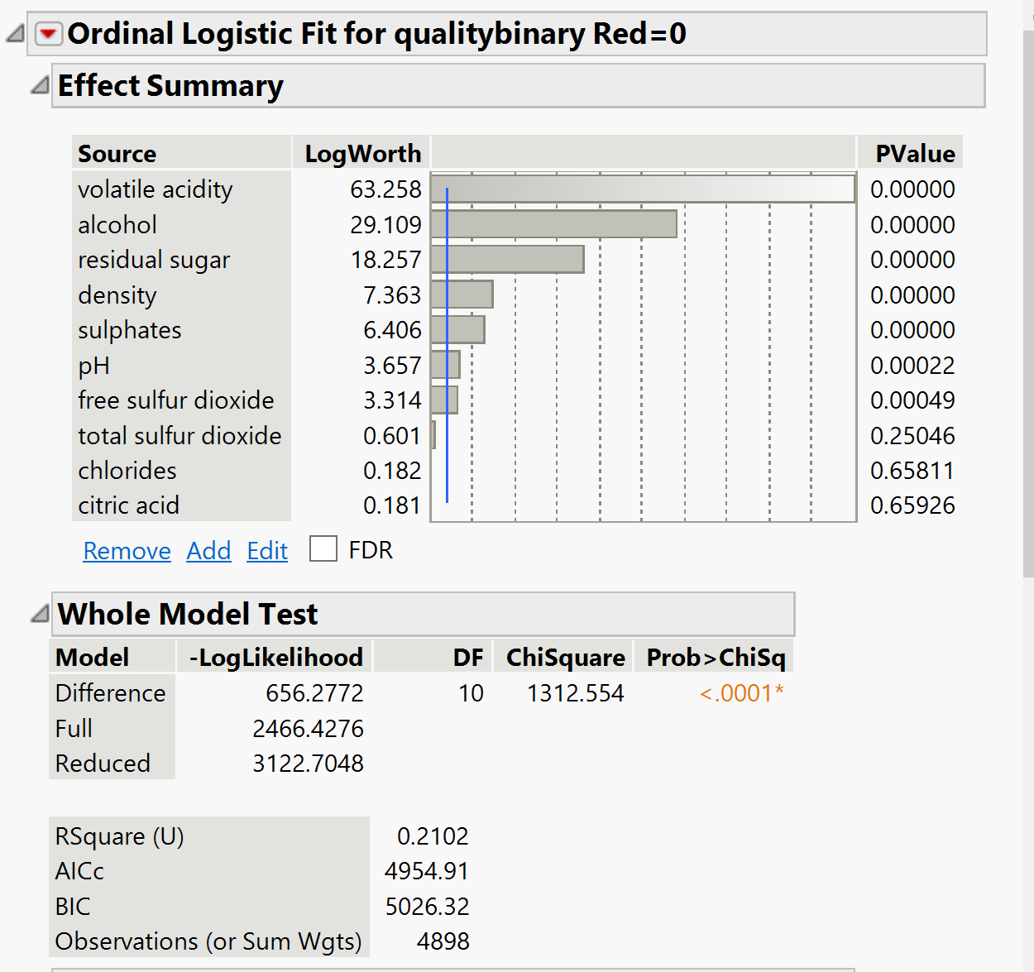
White Wine Logistic Regression Model
Data split between white and red wine for comparison
Rsquare result for this model was 21.02%
AICc was 4954.91
Volatile acidity was the most significant factor for white wine
Notes:
For each model that was used for analysis the data was split between red and white wine for comparison. We first see a logistic regression model run for the white wine data set. The model resulted in a Rsquared value of 21.02 % with an AIC value of 4954.91. Volatile acidity had the most influence on the quality score of qhite wine with a Logworth of 63.258.

Slide 6
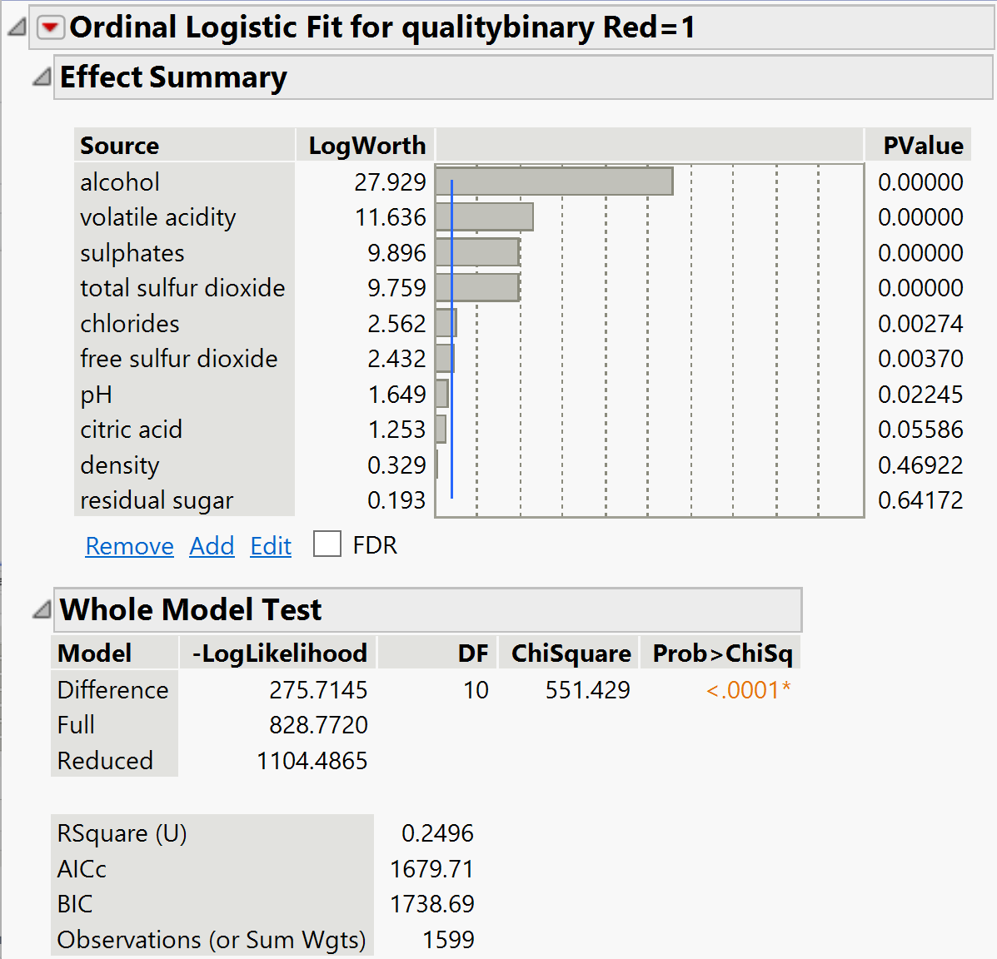
Red Wine Logistic Regression Model
Rsquare result for this model was 24.96%
AICc was 1679.71, significantly lower than what was see for white wine
Alcohol content was more significant for red wine
Notes:
We can see on this slide the comparable Logistic regression model for red wine. The Rsquared value is slightly higher with a result of 24.96%. The AIC value is significantly lower than the white wine model with a value of 1679.71 and we can see that Alcohol content had the highest influence on the quality score with a logworth of 27.929

Slide 7
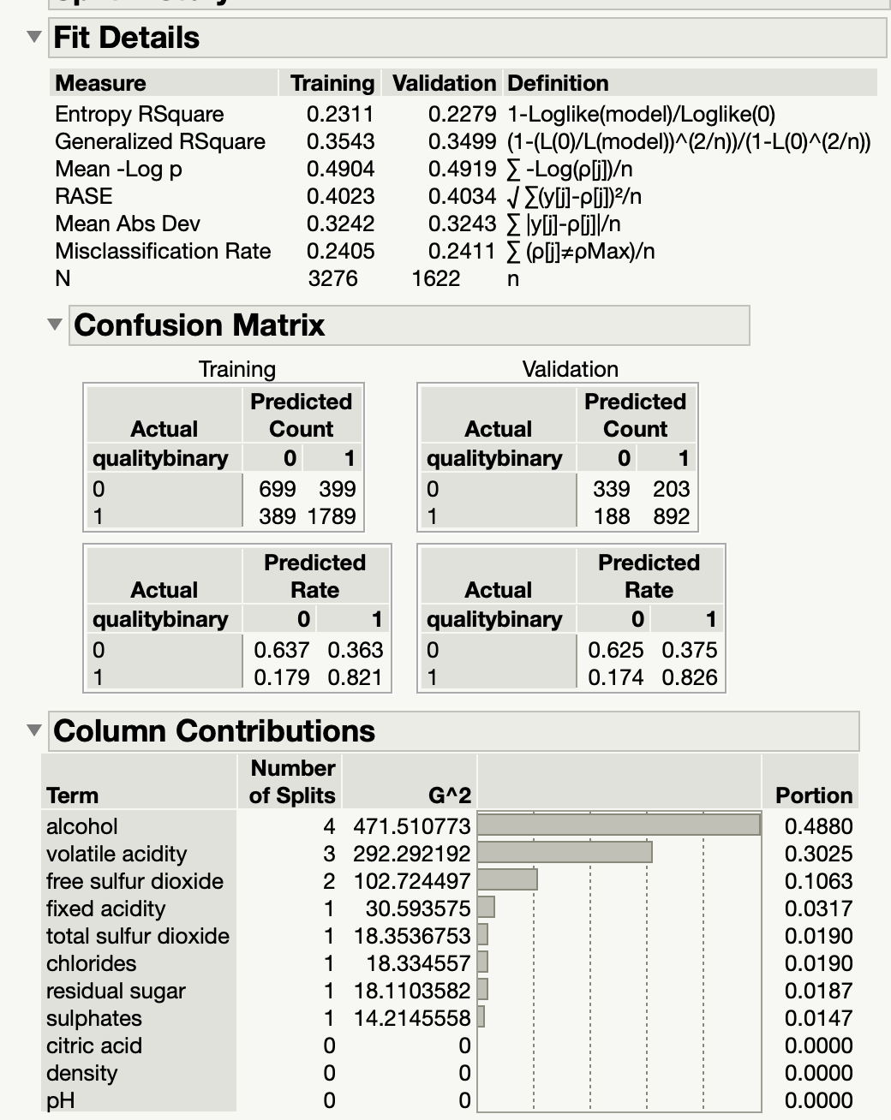
White Wine Decision Tree Model
Best split for White Wine using partition function was found to be 14.
Major Contributors - Alcohol,Volatile acidity, Free Sulfur dioxide, fixed acidity
Training
  R-Square - 0.3543, RASE - 0.4023
Validation
  R-Square - 0.3499, RASE - 0.4034
Notes:
For the Decision Tree Method, variables that are not transformed are input into the Partition Function.The go button in the Partition function was used to find the best split. As a result, the best split for white wine is 14 times with major contributors being Alcohol,Volatile acidity, Free Sulfur dioxide, fixed acidity.

Slide 8
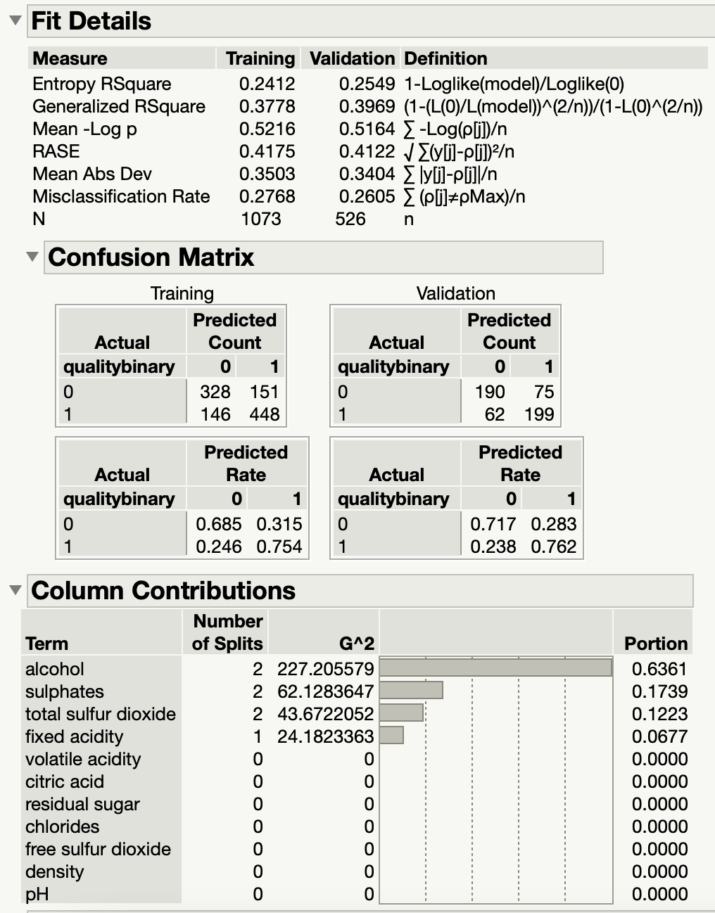
Red Wine Decision Tree Model
Best split for Red Wine using partition function was found to be 7.
Major Contributors - Alcohol,Sulphates, Total Sulfur dioxide, fixed acidity
Training
  R-Square - 0.3778, RASE - 0.4175
Validation
  R-Square - 0.3969, RASE - 0.4122
Notes:
For red wine, best split was identified to be 7. Major contributors were Alcohol,Sulphates, Total Sulfur dioxide, fixed acidity.
In both white and red wine analysis, decision tree model performed consistently well.

Slide 9
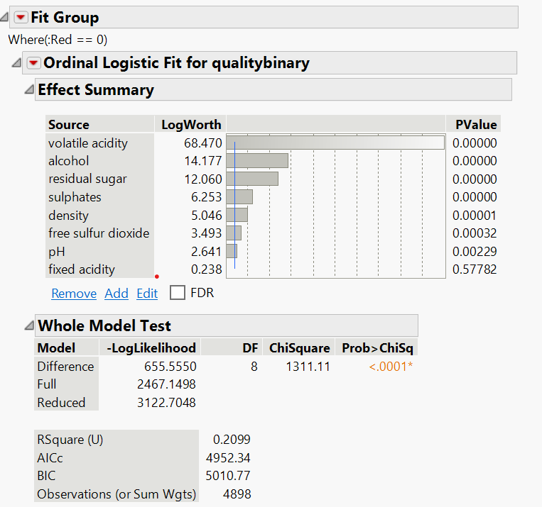
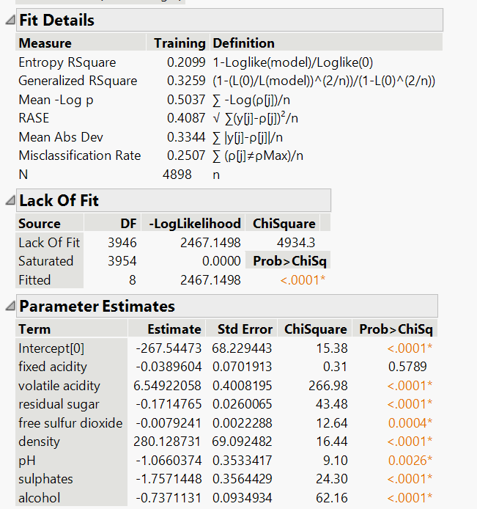
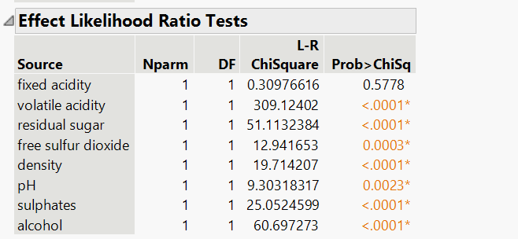
White Wine Stepwise Regression
Volatile acidity had the highest LogWorth - 68.470
Fixed acidity at the lowest LogWorth - 0.238
Volatile acidity had the lowest Pvalue - 0
Fixed acidity that had the highest Pvalue - 0.57782
Predictive capability with an Rsquare value of 21%
White wine had a very high AIC value - 4952.34
Notes:
In regard to white wine, after conducting a stepwise regression, we see that volatile acidity had the highest LogWorth at 68.470 compared to fixed acidity at the lowest LogWorth at 0.238. Also, interestingly, volatile had the lowest Pvalue of 0 compared to fixed acidity that had the highest Pvalue at 0.57782. We can also see the white wine model had a predictive capability with an Rsquare value of 21%. It can also be seen that white wine had a very high AIC value of 4952.34.

Slide 10
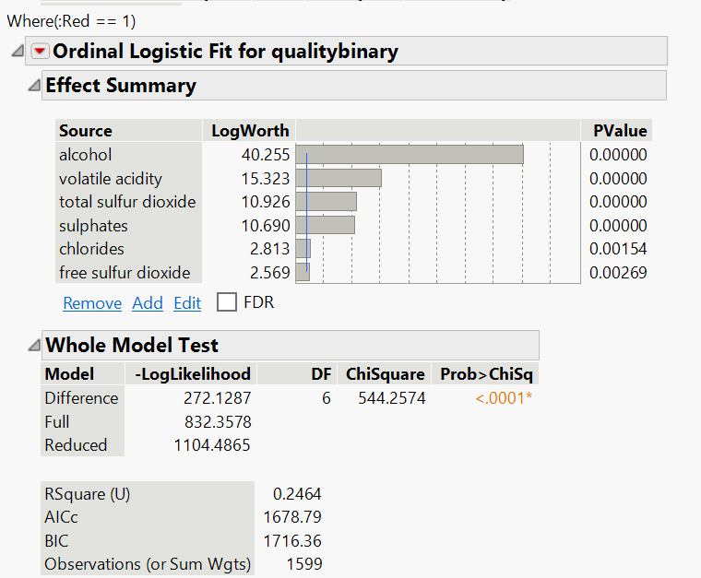
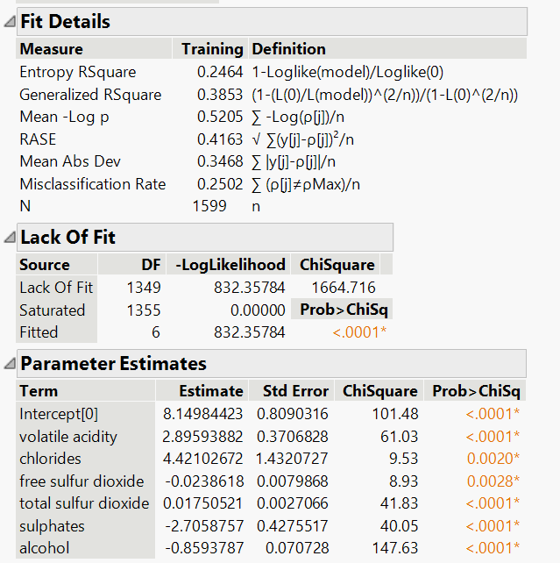
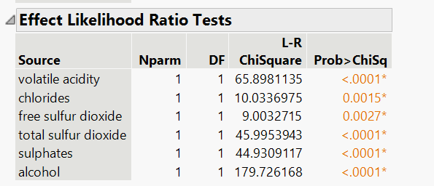
Red Wine Stepwise Regression
Alcohol had the highest LogWorth - 40.255
Free sulfur dioxide had the lowest LogWorth - 2.569
Alcohol having the lowest Pvalue - 0
Free sulfur dioxide with the highest Pvalue - 0.00269
Predictive capability with an Rsquare value of 24.6%
Red wine had a lower AIC of 1678.79
Stepwise regression performed slightly better on the red wine data set
Notes:
For red wine, it was shown that alcohol had the highest LogWorth at 40.255 and free sulfur dioxide had the lowest LogWorth at 2.569. The variables were reversed when it came to the Pvalue with alcohol having the lowest Pvalue of 0 and free sulfur dioxide with the highest Pvalue of 0.00269. After reviewing the stepwise regression model, we can also see the red wine model had a predictive capability with an Rsquare value of 24.6%. Also, the red wine had a lower AIC of 1678.79. Out of these two models, stepwise regression performed slightly better on the red wine data set but provided to be an ineffective modeling technique for the wine data set.

Slide 11
Model Findings
Model Name | Accuracy | RASE | Most Important Variables
Logistic Regression - White Wine | 21.02% | 0.4163 | volatile acidity, alcohol, residual sugar, density
Logistic Regression - Red Wine | 24.96% | 0.4147 | alcohol, volatile acidity, sulphate, total sulfur dioxide
Decision Tree Model - White Wine | 34.99% | 0.4023 | alcohol, volatile acidity, free sulfur dioxide, fixed acidity
Decision Tree Model - Red Wine | 39.69% | 0.4175 | alcohol, sulphate, total sulfur dioxide, fixed acidity
Stepwise Regression - White Wine | 20.99% | 0.4087 | volatile acidity, alcohol, residual sugar, sulphate
Stepwise Regression - Red Wine | 24.64% | 0.4163 | alcohol, volatile acidity, total sulfur dioxide, sulphate
Results :
Which variables affect the quality of red wine?
  Response: Alcohol, volatile acidity, sulphate, total sulfur dioxide.
Which variable affects the quality of white wine?
  Response: Volatile acidity, alcohol, residual sugar.
How does alcohol levels affect the quality of wine?
  Response: Alcohol level was found to be positively correlated with the quality score of both white and red wine.
Does fixed acidity improve the quality of wine?
  Response: The Decision tree model found Fixed acidity some effect on the quality score of both red and white wines but other models did not
Notes:
Reviewing the Findings for all of the models we can see that the Decision tree model had the highest Rsquared or accuracy rating with 34.99% and 39.69% for white and red wine respectively. The Root average squared error or the prediction error for the models was general consistent. Lastly we can see that the most important variable for the model prediction are relatively consistent with some models giving more weight to alcohol content or volatile acidity. Interestingly we see with the most accurate model the red wine decision tree that volatile acidity is not see to be a major predictor of wine quality.
-
When reviewing the original business questions asked we see that
Alcohol, volatile acidity sulphates, and total sulfur dioxide affect red wine quality
While Volatile acidity, alcohol content, and residual sugar affect white wine quality.
We found that alcohol level had a consistent effect on the wine quality score according to all models
We also found that fixed acidity was indicated to have an effect on wine for the decision tree model which performed the best out of the three models but other models did not identify Fixed acidity as a significant contributor to wine quality .

Slide 12
Summary
Recommendations
Our goal is to use predictive algorithms to measure the quality of wine.
A set of observations were considered on a number of red and white wine varieties involving various chemical properties.
Two datasets were used in this exercise involving red and white wine each having 1599 and 4898 records
This dataset was analyzed using the models; Logistic Regression, Decision Tree and Stepwise Regression
Out of the three models, decision tree has a higher accuracy rate, lower RASE, higher R-Square and performs better in predicting the quality of wine.
Finding a better model to conduct additional research to find more variables to then analyze which will increase the accuracy rate for white and red wines.
Variables to consider for better quality of white wine are alcohol, volatile acidity, free sulfur dioxide and fixed acidity.
Variables to consider for better quality of red wine are alcohol, sulphates, total sulfur dioxide and fixed acidity.
Notes:
Isa:
The primary goal of this research is to predict wine quality using machine learning techniques that include physio-chemical and chemical characteristics.Two datasets involving red and white wine each having 1599 and 4898 records was used in this analysis.R Square, RASE, Accuracy rate were used to assess the performance of a model. According to the findings, • decision tree has a higher accuracy rate, lower RASE, higher R-Square and performs better in predicting the quality of wine.
Reinee:
We have some recommendations to consider in the future that include finding a better model to conduct additional research to find more variables to then analyze which will increase the accuracy rate for white and red wines. Variables to consider for better quality of white wine are alcohol, volatile acidity, free sulfur dioxide and fixed acidity. Variables to consider for better quality of red wine are alcohol, sulphates, total sulfur dioxide and fixed acidity.
That concludes our presentation of the wine quality analysis for red and white wines.

